Slide 1
AZ-400.00 Learning Path 01: Get started on a DevOps transformation journey

Slide 2
Learning Path overview

Slide 3
Learning Path overview
Module 06: Introduction to source control
Module 01: Introduction to DevOps
Module 02: Choose the right project
Module 07: Describe types of source control systems
Module 03: Describe team structures
Module 08: Work with Azure Repos and GitHub
Module 04: Choose the DevOps tools
Labs & Learning Path review and takeaways
Module 05: Plan Agile with GitHub Projects and Azure Boards

Slide 4
Learning objectives
After completing this Learning Path, students will be able to:
Plan for the transformation with shared goals and timelines
Design a license management strategy (e.g., Azure DevOps users)
Select a project and identify project metrics and Key Performance Indicators (KPI’s)
Design a strategy for end-to-end traceability from work items to working software
Create a team and agile organizational structure
Design an authentication and access strategy
Design a strategy for integrating on-premises and cloud resources
Design a tool integration strategy
Notes:
This Learning Path explores the key areas that organizations must apply to start their DevOps transformation Journey, changing the team's mindset, and defining timelines and goals. By the end of this Learning Path, students will be able to:
Understand what DevOps is and the steps to accomplish it
Identify teams to implement the process
Plan for the transformation with shared goals and timelines
Plan and define timelines for goals

Slide 5
Learning objectives (continued)
After completing this Learning Path, students will be able to:
Describe the benefits of using Source Control
Describe Azure Repos and GitHub
Migrate from TFVC to Git

Slide 6
Module 01: Introduction to DevOps

Slide 7
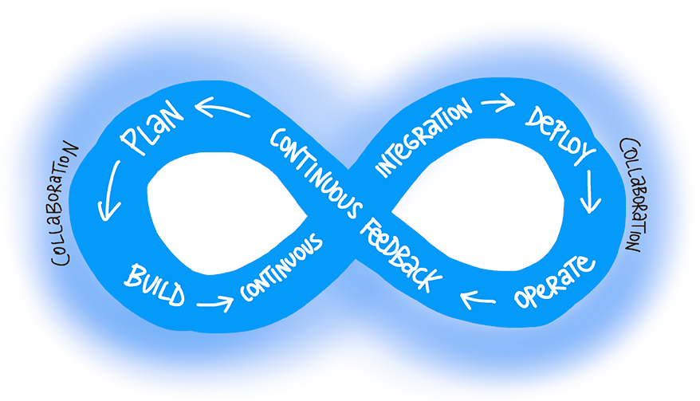
What is DevOps?
"DevOps is the union of people, process, and products to enable continuous delivery of value to end users."
– Donovan Brown, What is DevOps?
Notes:
https://docs.microsoft.com/en-us/azure/devops/learn/what-is-devops

Slide 8
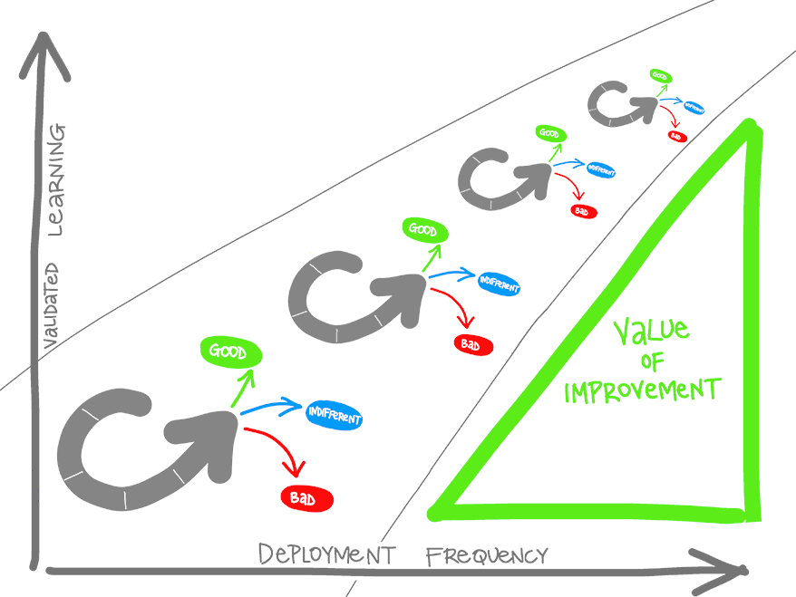
What is DevOps? (continued)
Understand your cycle time
Observe, Orient, Decide, Act (OODA) loop
Become data-informed
Strive for validated learning
Shorten your cycle time
Optimize validated learning
Notes:
https://docs.microsoft.com/en-us/azure/devops/learn/what-is-devops

Slide 9
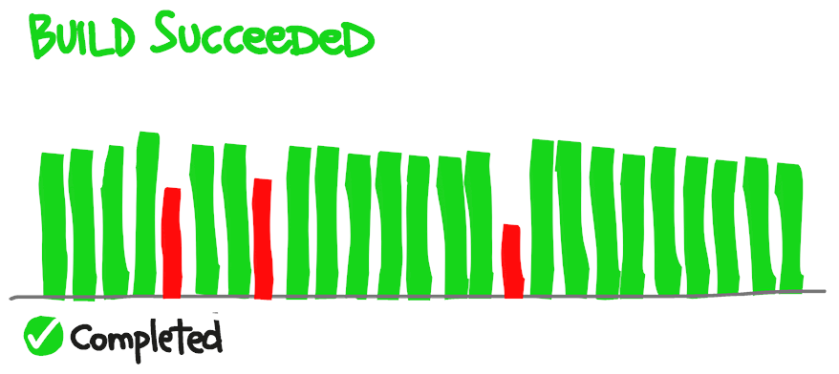
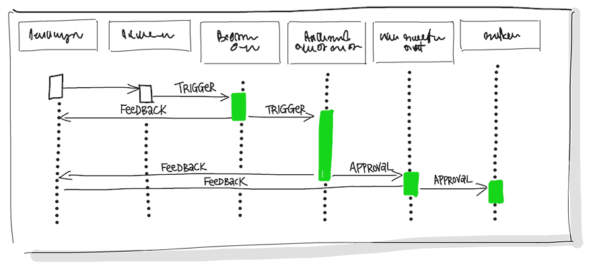
Explore the DevOps journey
Continuous Integration
Continuous Integration drives the ongoing merging and testing of code, which leads to finding defects early.
Continuous Delivery
Continuous Delivery of software solutions to production and testing environments helps organizations quickly fix bugs and respond to ever-changing business requirements.
Notes:
https://docs.microsoft.com/en-us/azure/devops/learn/what-is-devops
https://docs.microsoft.com/en-us/learn/modules/introduction-to-devops/3-explore-devops-journey
Continuous Integration drives the ongoing merging and testing of code, which leads to finding defects early. Other benefits include less time wasted on fighting merge issues and rapid feedback for development teams.
Continuous Delivery of software solutions to production and testing environments helps organizations quickly fix bugs and respond to ever-changing business requirements.

Slide 10
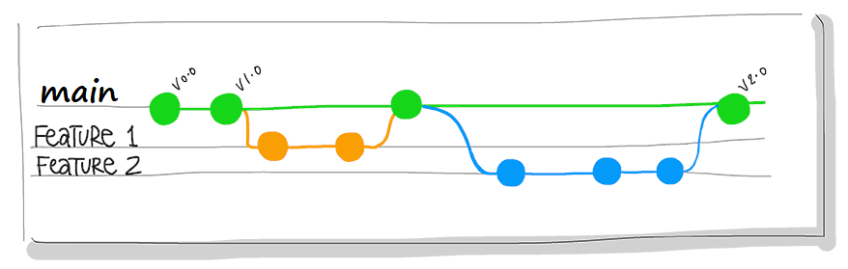
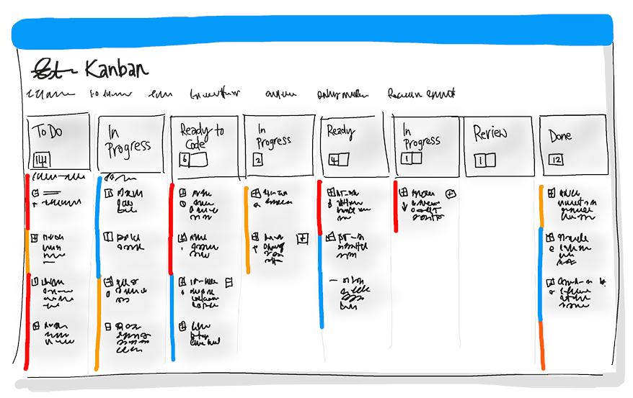
Explore the DevOps journey (continued)
Version Control
Version Control, usually with a Git-based Repository, enables teams located anywhere in the world to communicate effectively during daily development activities.
Agile/lean
Plan and isolate work into sprints.
Manage team capacity and help teams quickly adapt to changing business needs.
A DevOps Definition of Done is working software collecting telemetry against the intended business goals.
Notes:
https://docs.microsoft.com/en-us/azure/devops/learn/what-is-devops
https://docs.microsoft.com/en-us/learn/modules/introduction-to-devops/3-explore-devops-journey
Version Control, usually with a Git-based Repository, enables teams located anywhere in the world to communicate effectively during daily development activities. Also, integrate with software development tools for monitoring activities such as deployments.
Use Agile planning and lean project management techniques to:
Plan and isolate work into sprints.
Manage team capacity and help teams quickly adapt to changing business needs.
A DevOps Definition of Done is working software collecting telemetry against the intended business goals.

Slide 11
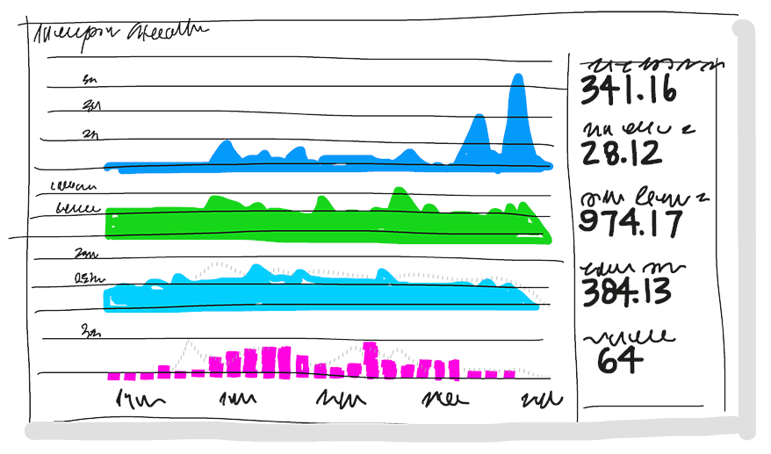

Explore the DevOps journey (continued)
Monitoring and logging
Monitoring and Logging of running applications.
Cloud
Public and Hybrid Clouds have made the impossible easy.
Notes:
https://docs.microsoft.com/en-us/azure/devops/learn/what-is-devops
https://docs.microsoft.com/en-us/learn/modules/introduction-to-devops/3-explore-devops-journey
Monitoring and Logging of running applications. Including production environments for application health and customer usage. It helps organizations create a hypothesis and quickly validate or disprove strategies. Rich data is captured and stored in various logging formats.
Public and Hybrid Clouds have made the impossible easy. The cloud has removed traditional bottlenecks and helped commoditize Infrastructure. You can use Infrastructure as a Service (IaaS) to lift and shift your existing apps or Platform as a Service (PaaS) to gain unprecedented productivity. The cloud gives you a data center without limits.

Slide 12
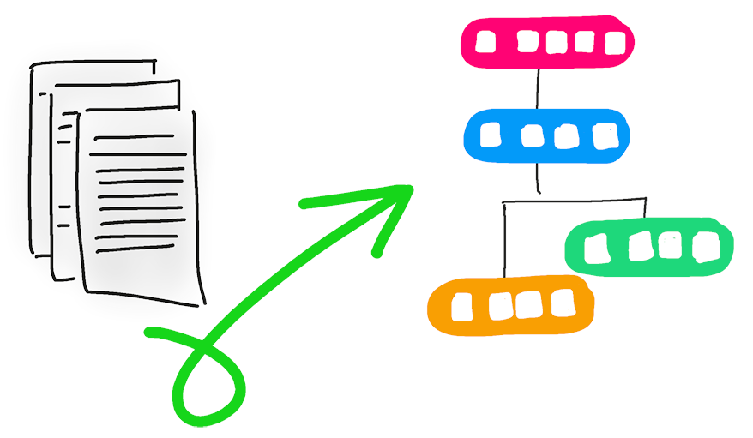
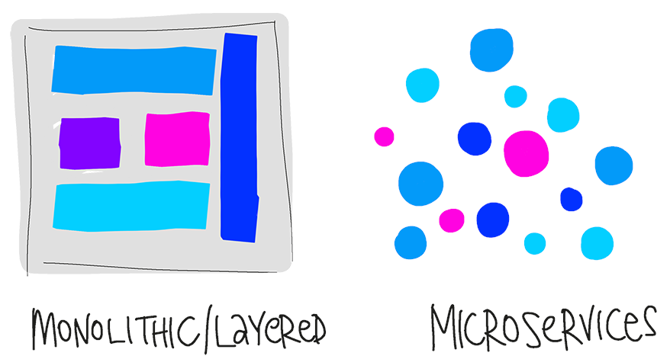
Explore the DevOps journey (continued)
Infrastructure as Code (IaC)
Enables the automation and validation of the creation and teardown of environments to help with delivering secure and stable application hosting platforms.
Microservices
Isolate business use cases into small reusable services that communicate via interface contracts.
Notes:
https://docs.microsoft.com/en-us/azure/devops/learn/what-is-devops
https://docs.microsoft.com/en-us/learn/modules/introduction-to-devops/3-explore-devops-journey
Infrastructure as Code (IaC): Enables the automation and validation of the creation and teardown of environments to help with delivering secure and stable application hosting platforms.
Use Microservices architecture to isolate business use cases into small reusable services that communicate via interface contracts. This architecture enables scalability and efficiency.

Slide 13
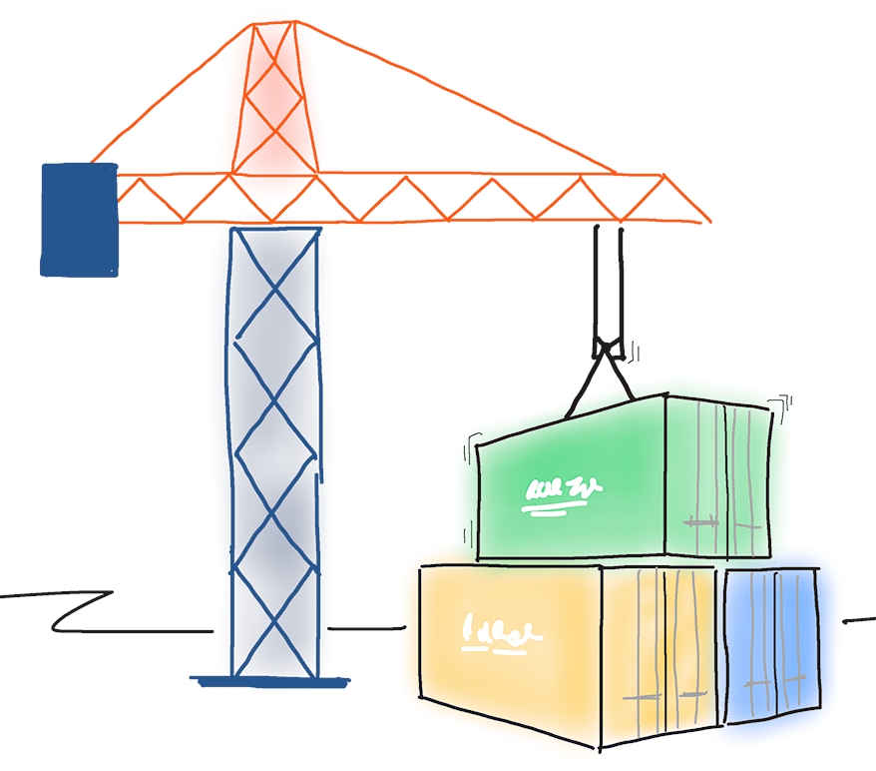
Explore the DevOps journey (continued)
Containers
Containers are the next evolution in virtualization.
DevOps may hurt at first
Notes:
https://docs.microsoft.com/en-us/azure/devops/learn/what-is-devops
https://docs.microsoft.com/en-us/learn/modules/introduction-to-devops/3-explore-devops-journey
Containers are the next evolution in virtualization. They are much more lightweight than virtual machines, allow much faster hydration, and easily configure files.
DevOps may hurt at first.
If it hurts, do it more often. Just like going to the gym, adopting new practices is likely to hurt at first. The more often you exercise the new techniques, the easier they will become.
Like training at the gym, where you first exercise large muscles before small muscles, adopt practices that have the most significant impact. Cross-train to develop synergy.

Slide 14

Identify transformation teams
There are several challenges when creating teams:
Availability of staff
Disruption of current procedures and processes
To overcome the challenges, create a team that is:
Focused on the transformation
Well respected in their subject areas
Internal and external to the business
A transformation project can conflict with ongoing business needs

Slide 15
Explore shared goals and define timelines
Projects must have a clearly-defined set of measurable outcomes, like:
Reduce the time spent on fixing bugs by 60%
Reduce the time spent on unplanned work by 70%
Reduce the out-of-hours work required by staff to no more than 10% of total working time
Remove all direct patching of production systems
One of the key aims of DevOps is to provide greater customer value, so outcomes should have a customer value focus

Slide 16
Explore shared goals and define timelines (continued)
Measurable goals should have timelines that challenging yet achievable
Timelines should be a constant series of short-term goals – each clear and measurable
Shorter timelines have advantages:
Easier to change plans or priorities when necessary
Reduced delay between doing the work and getting feedback
Easier to keep organizational support when positive outcomes are apparent

Slide 17
Module 02: Choose the right project

Slide 18
Explore greenfield and brownfield projects
Greenfield software projects develop in a totally new environment.
Brownfield software projects develop in the immediate presence of existing software applications/systems.

Slide 19
Decide when to use greenfield and brownfield projects
Greenfield projects:
Appears to be an easier starting point
A blank slate offers the chance to implement everything the way you want.
Brownfield projects:
Comes with the baggage of existing code bases, existing teams and often a great amount of technical debt
Spending time maintaining existing Brownfield applications, limits the ability to work on new code.
There is a common misconception that DevOps suits greenfield projects better than brownfield projects, but this is not the case.

Slide 20
Decide when to use systems of record versus systems of engagement
Systems of record:
Emphasize accuracy and security
Provide the truth about data elements
Historically evolve slowly and carefully
Systems of engagement:
Are more exploratory
Use experimentation to solve new problems
Are modified regularly
Prioritize making changes quickly over ensuring that the changes are correct
Both types of systems are important

Slide 21
Identify groups to minimize initial resistance
Different types of staff members:
Canaries voluntarily test bleeding edge features
Early adopters voluntarily preview releases
Users consume the products after canaries and early adopters
Ideal Target Improvements:
Can be used to gain early wins
Are small enough to be achievable in a reasonable time-frame
Have benefits that are significant enough to be obvious to the organization
Notes:
✔️ The aim is to build a snowball effect where each new successful outcome adds to previous successful outcomes. This will maximize the buy-in from all those affected.

Slide 22
Identify project metrics and key performance indicators (KPIs)
Faster outcomes – Deployment frequency, deployment speed, deployment size, and lead time
Efficiency – Server to admin ratio, staff member to customers ratio, application usage, and application performance
Quality and security – Deployment failure rates, application failure rates, mean time to recover, bug report rates, test pass rates, defect escape rate, availability, service level agreement (SLA) achievement, and mean time to detection
Culture – Employee morale and retention rates
Goals must be specific, measurable, and time-bound

Slide 23
Module 03: Describe team structures

Slide 24
Explore agile development practices
Waterfall approach:
Define, analyze, build and test, and deliver
Hard to accurately define requirements, which can change over time, including during development
Requires change requests and additional cost after delivery
Agile approach:
Emphasizes constantly adaptive planning, and early delivery with continual improvement
Development methods are based on releases and iterations
At the end of each iteration, should have tested working code
Is focused on shorter-term outcomes
Notes:
x

Slide 25
Explore principles of agile development
Measure progress through working software
1
Satisfy the customer through early and continuous delivery of valuable software
7
Agile processes promote sustainable development
2
Welcome changing requirements
8
Continuous attention to technical excellence and good design
3
Deliver working software frequently
9
4
10
Simplicity - the art of maximizing the amount of work not done
Work together throughout the project
5
Build projects around motivated individuals
11
Use self-organizing teams
6
Use face-to-face conversation
12
Reflect on how to become more effective
Source: https://www.agilealliance.org/agile101/12-principles-behind-the-agile-manifesto/
Notes:
12 Principles Behind the Agile Manifesto - https://www.agilealliance.org/agile101/12-principles-behind-the-agile-manifesto/

Slide 26
Define organization structure for agile practices
Horizontal team structures divide teams according to the software architecture.
Vertical teams span the architecture and are aligned with product outcomes, and scaling can occur by adding teams.
Vertical teams have been shown to provide stronger outcomes in Agile projects

Slide 27
Explore ideal DevOps team members
Think there is a need to change and have shown an ability to innovate
Are well-respected and have broad knowledge of the organization and how it operates
Ideally, already believe that DevOps practices are what is needed
Many teams hire external agile coaches or mentors
Agile coaches have teaching and mentoring skills
Agile coaches tend to be both trainers and consultants
Some coaches are technical experts
Some coaches are focused on agile processes
Team members must learn as they work, and acquire skills from each other
Notes:
https://docs.microsoft.com/en-us/learn/modules/describe-team-structures/5-explore-ideal-devops-team-members
When they first start an agile transformation, many teams hire external coaches or mentors.
Agile coaches help teams or individuals to adopt agile methods or to improve the current techniques and practices.
They must be agents of change by helping people understand how they work and encouraging them to adopt new approaches.
Agile coaches typically work with more than one team and remove any roadblocks from inside or outside the organization.
This work requires various skills, including coaching, mentoring, teaching, and making easier. Agile coaches must be both trainers and consultants.
There is more than one type of agile coach.

Slide 28
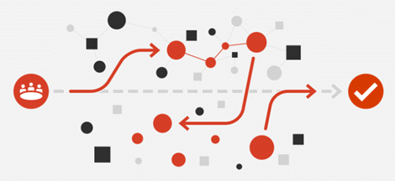
Enable in-team and cross-team collaboration
Cultural changes – More open workspaces, meeting etiquette, outsourcing, better communication
Cross-functional teams – Collaboration with others, diversity of opinion, rewarding collective behavior
Collaboration tooling –Slack, Teams, Asana, Glip, JIRA

Slide 29
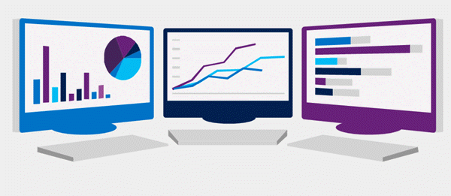
Select tools and processes for agile practices
Tools can often enhance the outcomes achieved.
Physical tools such as white boards, index cards, sticky notes
Project Management tools such as Kanban boards for planning, monitoring, and visualization
Screen recording tools for recording bugs, building walk-throughs, and demonstrations

Slide 30

Module 04: Choose the DevOps tools

Slide 31
What is Azure DevOps?
Azure Boards: Agile planning, work item tracking, visualization and reporting tool
Azure Pipelines: A language, platform and cloud agnostic CI/CD platform with support for containers or Kubernetes
Azure Repos: Provides cloud-hosted private git repos
Azure Artifacts: Provides integrated package management with support for Maven, npm, Python and NuGet package feeds from public or private sources
Azure Test Plans: Provides an integrated planned and exploratory testing solution

Slide 32
What is GitHub?
Codespaces: Provide cloud-hosted collaborative development environments
Repos: Provide cloud-hosted and on-premises git repos for both public and private projects
Actions: Create automation workflows with environment variables and customized scripts
Packages: Ease integration with numerous existing packages and open-source repositories
Security: Review code and identity vulnerabilities early in the development cycle

Slide 33
Explore an authorization and access strategy
Azure DevOps Services uses either a Microsoft account or Azure Active Directory, to protect and secure your data
For non-Microsoft tools like Git, NuGet, or Xcode you can use personal access tokens
Azure DevOps is pre-configured with default security groups and permissions
You can also configure app access policies and conditional access policies

Slide 34

Migrate or integrate existing work management tools
Both Azure DevOps and GitHub can be integrated with a wide variety of existing work management tools:
Trello integration tooling is a free, flexible, and visual way to organize anything with anyone.
Solidify offers a tool for Jira to Azure DevOps migration.
Third party organizations offer commercial tooling to assist with migrating other work management tools like Aha, BugZilla, ClearQuest.

Slide 35
Migrate or integrate existing test management tools
Azure Test Plans are used to track sprints and milestones. There is a Test & Feedback extension available in the Visual Studio Marketplace.
Other tools:
Apache JMeter is open-source software written in Java and designed to load test functional behavior and measure performance.
Pester is a tool that can be used to automate the testing of PowerShell code.
SoapUI provides another testing framework for SOAP and REST testing.
If you are using Microsoft Test Manager, you should plan to migrate to Azure Test Plans
Notes:
For more information, you can see:
Marketplace search for test management - [(https://marketplace.visualstudio.com/search?term=test%20management&target=AzureDevOps&category=All%20categories&sortBy=Relevance)](https://marketplace.visualstudio.com/search?term=test%20management&target=AzureDevOps&category=All%20categories&sortBy=Relevance)

Slide 36
Design a license management strategy
Azure DevOps can be licensed for individual services or for users. It offers free and paid tiers:
https://azure.microsoft.com/en-us/pricing/details/devops/azure-devops-services/
GitHub can be licensed for individuals, teams, and enterprises. It offers free and paid tiers:
https://github.com/pricing

Slide 37
Module 05: Plan Agile with GitHub Projects and Azure Boards

Slide 38
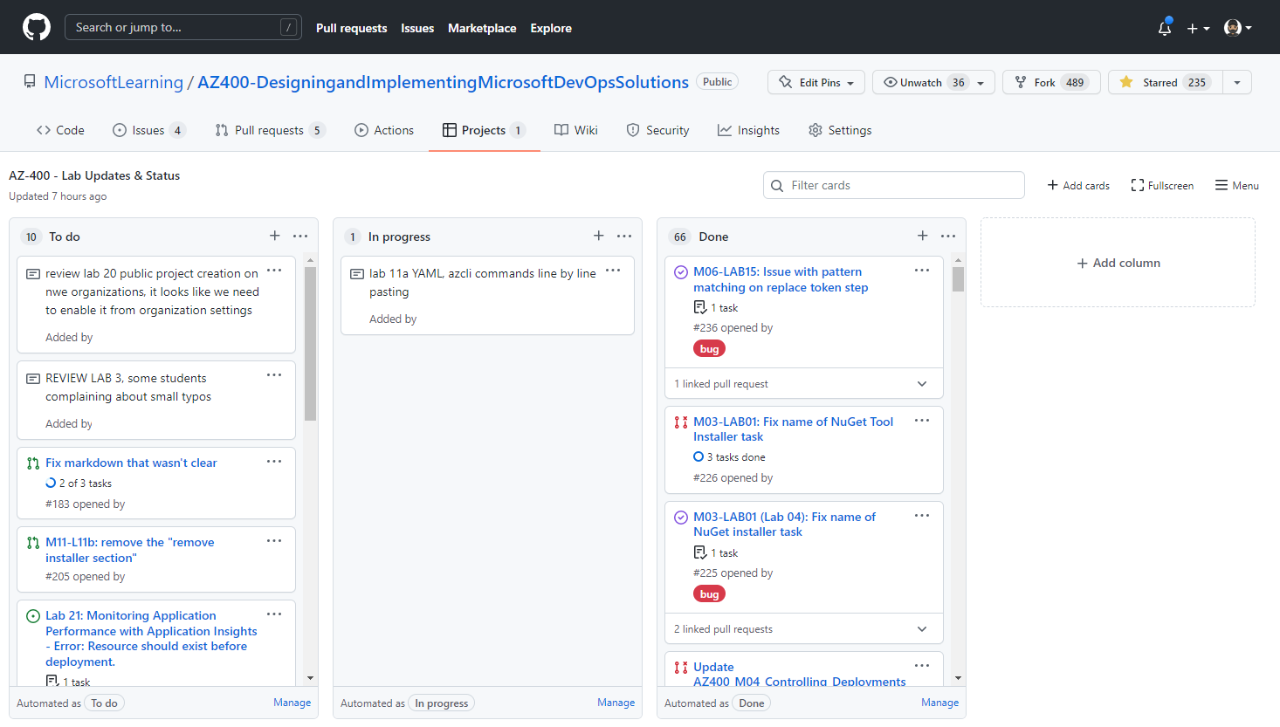
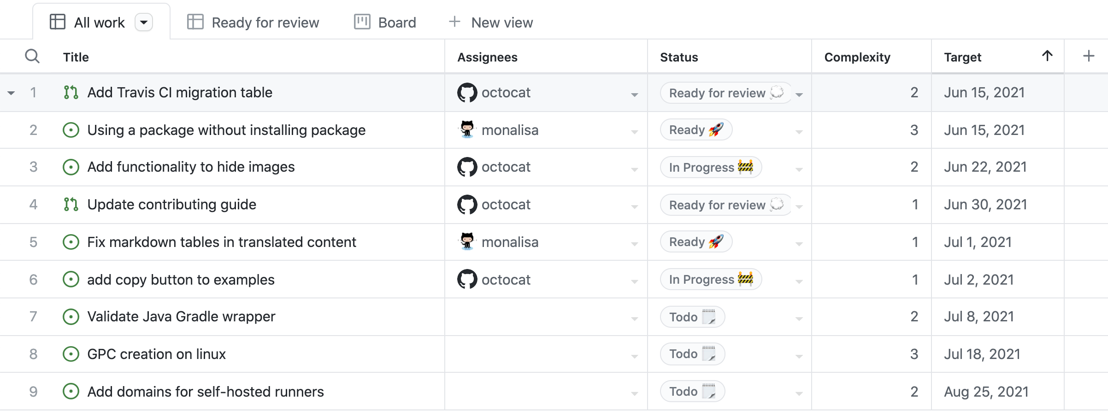
Introduction to GitHub Projects and Project boards
GitHub Project Boards Project boards are made up of issues, pull requests, and notes categorized as cards that you can drag and drop into your chosen columns.
GitHub Projects (beta) are a new, customizable and flexible tool version of projects for planning and tracking work on GitHub.
Notes:
Explain GitHub Project Boards and how it controls issues and pull requests. Focus on GitHub Projects (beta) and explain this new version has a lot more features and control over the projects.
Projects (beta) are a new, customizable and flexible tool version of projects for planning and tracking work on GitHub. Projects (beta) are currently in public beta and subject to change. A project is a customizable spreadsheet that you can configure the layout by filtering, sorting, and grouping your issues and PRs, and adding custom fields to track metadata. You can use different views such as Board or spreadsheet/table.

Slide 39
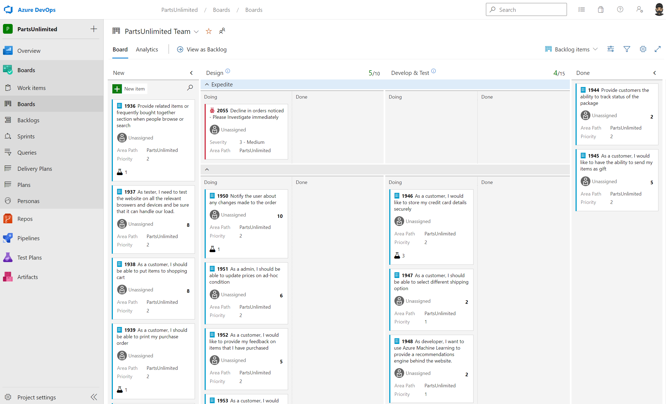
Introduction to Azure Boards
Agile, Scrum, and Kanban processes by default.
Track work, issues, and code defects associated with your project.
Notes:
Explain about Azure Boards and its capabilities.
Azure Boards is a customizable tool to manage software projects supporting Agile, Scrum, and Kanban processes by default.
Track work, issues, and code defects associated with your project. Also, you can create your custom process templates and use them to create a better and more customized experience for your company.
You have multiple features and configurations to support your teams, such as calendar views, configurable dashboards, and integrated reporting.
The Kanban board is one of several tools that allows you to add, update, and filter user stories, bugs, features, and epics.

Slide 40
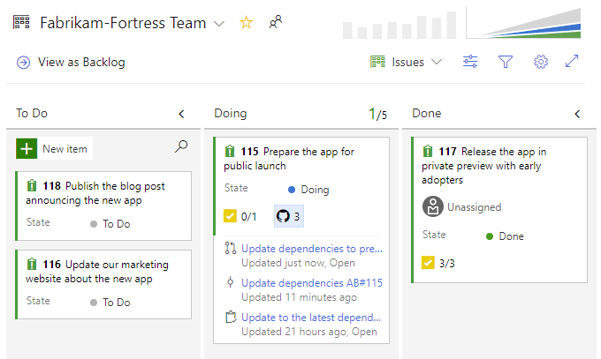
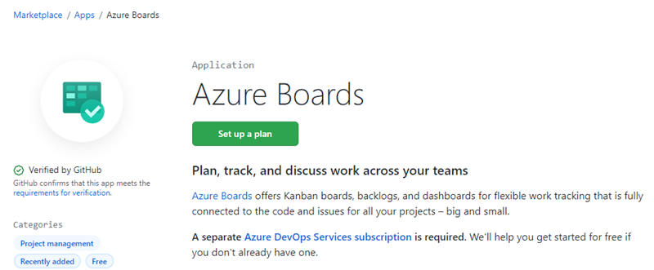
Link GitHub to Azure Boards
Use Azure Boards to plan and track your work, and GitHub as source control for software development.
Authenticate to GitHub using a username/password or a personal access token (PAT).
Azure Boards App links commits, pull requests, and issues, directly to work items
Notes:
Explain how to integrate Azure Boards and GitHub and its benefits.
Talk about what is supported or not:
Supported integration scenarios
Azure Boards-GitHub integration supports the following connections:
From GitHub:
Support integration for all repositories for a GitHub account or organization or select repositories.
Add or remove GitHub repositories participating in the integration and configure the project they connect to.
Suspend Azure Boards-GitHub integration or uninstall the app.
From Azure Boards:
Connect one or more GitHub repositories to an Azure Boards project.
Add or remove GitHub repositories from a GitHub connection within an Azure Boards project.
Completely remove a GitHub connection for a project.
Allow a GitHub repository to connect to one or more Azure Boards projects within the same Azure DevOps organization or collection.
Azure Boards-GitHub integration supports the following operational tasks:
Create links between work items and GitHub commits, pull requests, and issues based on GitHub mentions.
Support state transition of work items to a "Done" or "Completed" state when using GitHub mention by using fix, fixes, or fixed.
Support full traceability by posting a discussion comment to GitHub when linking from a work item to a GitHub commit, pull request, or issue.
Show linked to GitHub code artifacts within the work item Development section.
Show linked to GitHub artifacts as annotations on Kanban board cards.
Support status badges of Kanban board columns added to GitHub repositories.
The following tasks aren't supported at this time:
Query for work items with links to GitHub artifacts. However, you can query for work items with an External Link Count > 0.

Slide 41
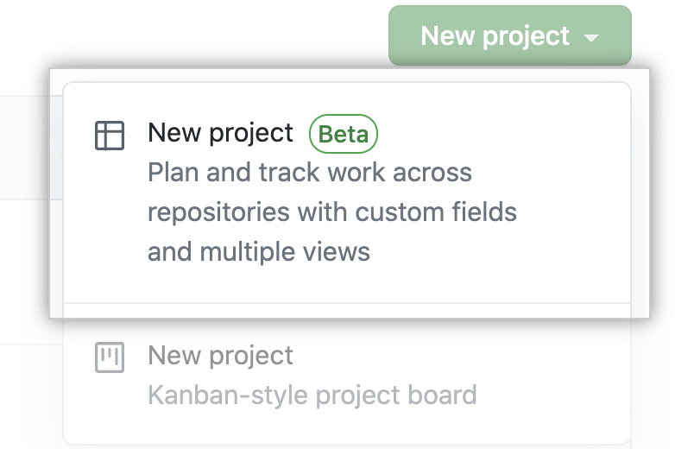
Configure GitHub Projects
You can use a project board template to create a project board with automation already configured.
You can also copy a project board to reuse its customizations for similar projects.
You can link up to twenty-five repositories to your organization or user-owned project board.
Once you've created your project board, you can add issues, pull requests, and notes to it.
Notes:
Explain GitHub Projects (beta) creation, configuration and its possibilities.
https://docs.github.com/en/issues/organizing-your-work-with-project-boards/managing-project-boards/creating-a-project-board

Slide 42
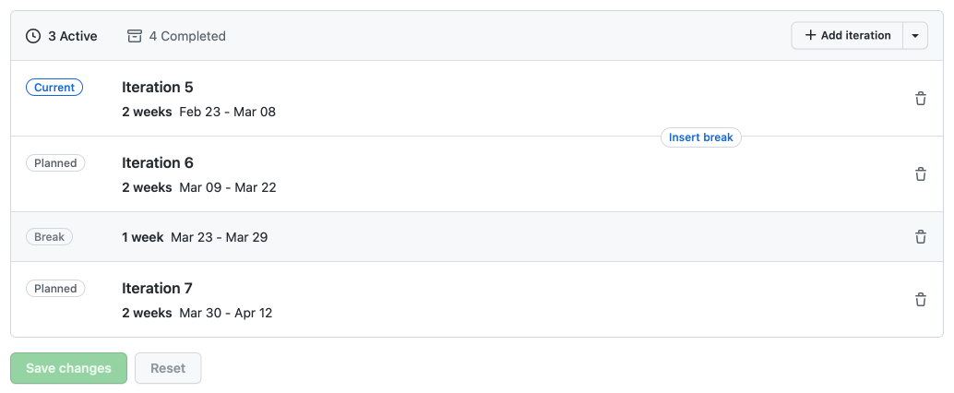
Manage work with GitHub Project boards
Control project deliverables
Set to any length of time
Include breaks
Release dates
Iterations to planning upcoming work
Notes:
Explain GitHub Projects (beta) boards and how to control work using iterations, releases, and best practices.
https://docs.github.com/issues/trying-out-the-new-projects-experience/managing-iterations
https://docs.github.com/issues/trying-out-the-new-projects-experience/best-practices-for-managing-projects

Slide 43
Customize Project views
Organize information by changing the layout, grouping, sorting, and filtering your work.
Use Command Palette:
Switch layout: Table.
Show: Milestone.
Sort by: Assignees, asc.
Group by: Status.
Column field by: Status.
Filter by Status.
Delete view.
Notes:
Explain Project views and customizations. Command palette for customize.
Project command palette
Use the project command palette to change settings and run commands in your project.
Open the project command palette by pressing Command + K (Mac) or Ctrl + K (Windows/Linux).
Type any part of a command or navigate through the command palette window to find a command.
You have multiple commands to apply, such as:
Switch layout: Table.
Show: Milestone.
Sort by: Assignees, asc.
Remove sort-by.
Group by: Status.
Remove group-by.
Column field by: Status.
Filter by Status.
Delete view.
https://docs.github.com/get-started/using-github/github-command-palette

Slide 44
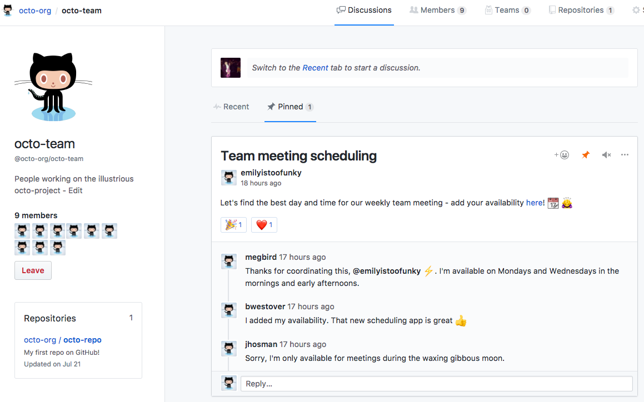
Collaborate using team discussions
GitHub discussions can help make your team plan together, update one another, or talk about any topic.
Across projects or repositories conversations (issues, pull requests, etc.).
Notes:
Explain team discussions.
With team discussions you can:
Post on your team's page or participate in a public discussion.
Link to any team discussion to reference it elsewhere.
Pin important posts to your team's page.
Receive email or web notifications.
Team discussions are available in organizations by default.

Slide 45
Demonstration: GitHub Project Boards and Projects (beta)
DEMO
Notes:
Take a moment to complete the demonstration showing GitHub Project Boards and Projects (beta).
Show how to customize columns, fields, configure boards, etc.

Slide 46
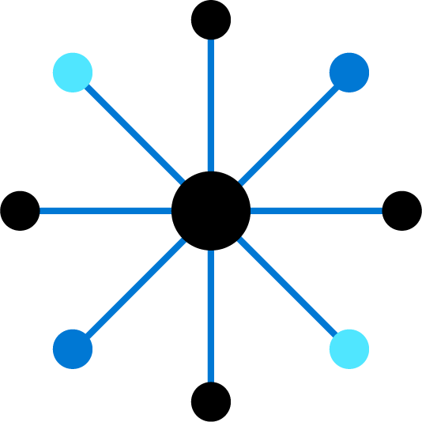
Module 06: Introduction to source control

Slide 47
Introduction
When it was introduced, DevOps was a revolutionary way to release software quickly and efficiently while maintaining a high level of security.
Source control (version control) is a critical part of DevOps.

Slide 48
Explore DevOps foundational practices
Foundational practices and the stages of DevOps evolution: stages 0 to 2
 | Defining practices and associated practices | Practices that contribute to success
Stage 0 | Monitoring and alerting are configurable by the team operating the service Deployment patterns for building applications or services are reused Testing patterns for building applications or services are reused Teams contribute improvements to tooling provided by other teams Configurations are managed by a configuration management tool
Stage 1 | Application development teams use version control Teams deploy on a standard set of operating systems | Build on a standard set of technology Put application configurations in version control Test infrastructure changes before deploying to production Source code is available to other teams
Stage 2 | Build on a standard set of technologies Teams deploy on a single standard operating system | Deployment patterns for building applications and services are reused Rearchitect applications based on business needs Put system configurations in version control
* The practices that define each stage are highlighted in bold font
Notes:
State of DevOps report - https://puppet.com/resources/report/state-of-devops-report

Slide 49
Explore DevOps foundational practices (continued)
Foundational practices and the stages of DevOps evolution: stages 3 to 5
 | Defining practices and associated practices | Practices that contribute to success
Stage 3 | Individuals can do work without manual approval from outside the team Deployment patterns for building applications and services are reused Infrastructure changes are tested before deploying to production | Individuals can make changes without significant wait times Service changes can be made during business hours Post-incident reviews and results are shared Teams build on a standard set of technologies Teams use continuous integration Infrastructure teams use version control
Stage 4 | System configurations are automated Provisioning is automated Application configurations are in version control Infrastructure teams use version control | Security policy configurations are automated Resources made available via self-service
Stage 5 | Incident responses are automated Resources available via self-service Rearchitect applications based on business needs Security teams are involved in technology design and deployment | Security policy configurations are automated Application developers deploy testing environments on their own Success metrics for projects are visible Provisioning is automated
* The practices that define each stage are highlighted in bold font
Notes:
State of DevOps report - https://puppet.com/resources/report/state-of-devops-report

Slide 50
What is source control?
A source control system allows developers to collaborate on code and track changes. Use version control to save your work and coordinate code changes across your team.
The version control system saves a snapshot of your files (history) so that you can review and even roll back to any version of your code with ease.
Source control protects source code from catastrophe and the casual degradation of human error and unintended consequences.

Slide 51
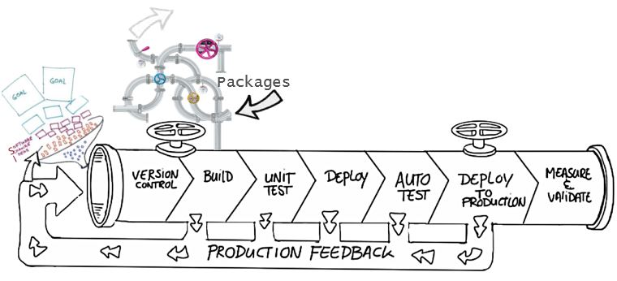
Explore benefits of source control
Create workflows
Work with versions
Collaboration
Maintains history of changes
Automate tasks
Notes:
Benefits include: Reusability, traceability, manageability, efficiency, collaboration, and learning

Slide 52
Explore best practices for source control
Make small changes
Don’t commit personal files
Update often and right before pushing to avoid merge conflicts
Verify your code change before pushing it to a repository; ensure it compiles and tests are passing
Pay close attention to commit messages as these will tell you why a change was made
Link code changes to work items
No matter your background or preferences, be a team player and follow agreed conventions and workflows

Slide 53
Module 07: Describe types of source control systems

Slide 54
Understand centralized source control
Strengths | Best Used for
Easily scales for very large codebases Granular permission control Permits monitoring of usage Allows exclusive file locking | Large integrated codebases Audit and access control down to the file level Hard to merge file types
Centralized
There is a single central copy of your project, and programmers commit their changes to this central copy.
Common centralized source control systems are TFVC, CVS, Subversion (or SVN), and Perforce.

Slide 55
Understand distributed source control
Strengths | Best Used for
Cross platform support An open-source friendly code review model via pull requests Complete offline support Portable history An enthusiastic growing user base | Smaller size (in bytes) and modular codebases Evolving through open-source Highly distributed teams Teams working across platforms Greenfield codebases
Distributed
Every developer clones a copy of a repository and has the full history of the project.
Common distributed source control systems are Mercurial, Git, and Bazaar.
Notes:
A greenfield project is one that lacks constraints imposed by prior work.

Slide 56
Explore Git and Team Foundation Version Control
Git:
Distributed Source Control system
Each developer has a copy of the source repository on their development system
TFVC:
Centralized Source Control system
Team members have only one version of each file on their dev machines.
In the server workspaces model, before making changes, team members publicly check out files.
In the local workspaces model, each team member takes a copy of the latest version of the codebase with them and works offline as needed.

Slide 57
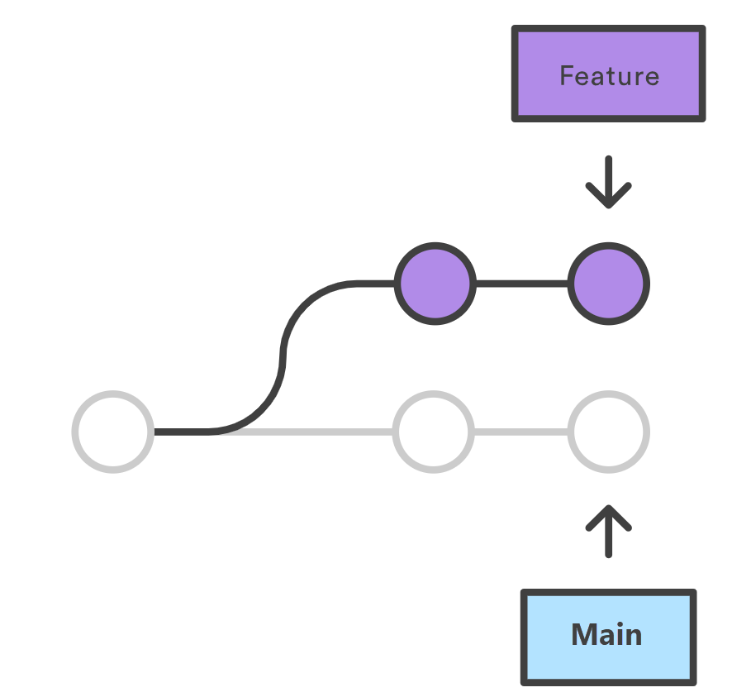
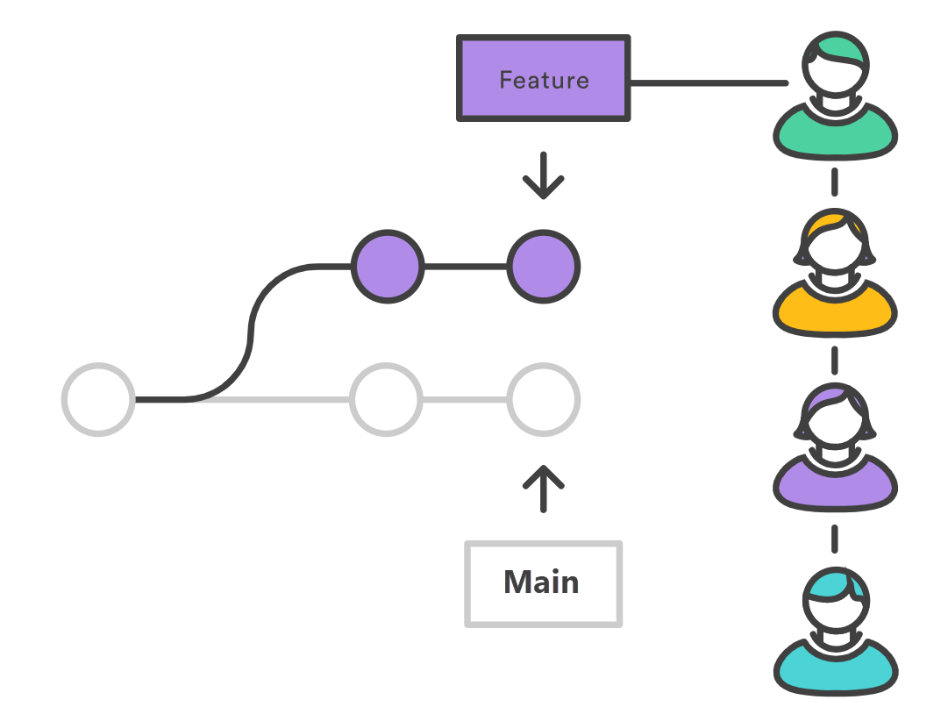
Examine and choose Git
Feature branches
Distributed development
Pull requests
Community
Release cycles

Slide 58
Understand objections to using Git
Overwriting History – If used incorrectly, it can lead to conflicts
Large Files – Git works best with repos that are small and that do not contain large files (or binaries); consider using Git LFS support
Learning Curve – Some training and instruction will be needed. Existing developers might need to be retrained.
Discussion – What objections do you have?

Slide 59
Describe working with Git locally
DEMO
Notes:
Take a moment to complete the demonstration, as defined in the student manual.

Slide 60
Module 08: Work with Azure Repos and GitHub

Slide 61
Introduction to Azure Repos
Set of version control tools to manage your code:
Tightly integrated with other Azure DevOps features
Can connect from common development environments
Policy based management to protect branches
Offers two styles of version control:
Git: Distributed version control
Team Foundation Version Control (TFVC): Centralized version control

Slide 62
Introduction to GitHub
Largest open-source community
Features of GitHub:
Automate from code to cloud
Securing software, together
Seamless code review
Code and documentation in one place
Coordinate
Manage teams

Slide 63
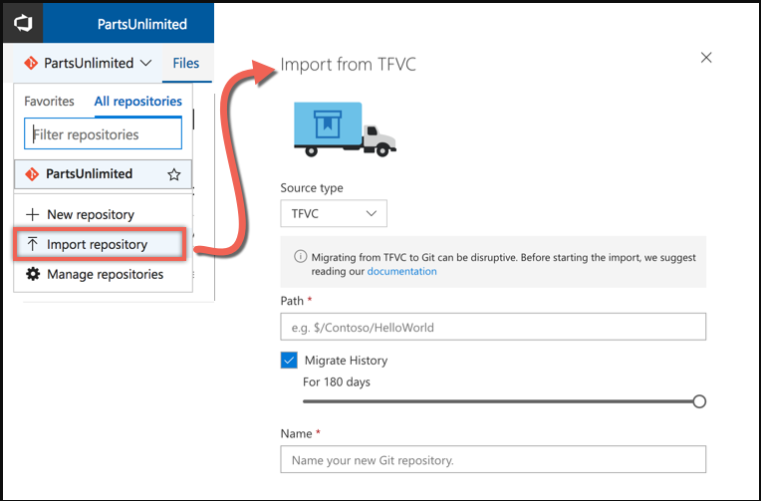
Migrate from TFVC to Git
Single branch import
Full synchronization (git-tfs)

Slide 64
Migrate from TFVC to Git (continued)
Migrating the tip:
Only the latest version of the code
History remains on the old server
Migrating with history:
Tries to mimic the history in Git
Recommend to migrate the tip, because:
History is stored differently – TFVC stores change sets, Git stores snapshots of the repository
Branches are stored differently – TFVC branches folders, Git branches the entire repository
Notes:
Video: https://www.youtube.com/watch?v=QsJdFkMKLN0

Slide 65
Develop online with GitHub Codespaces
Cloud-based development environment hosted by GitHub
Avoids issues with old hardware/software
Based on Visual Studio Code
Highly portable
Work from PCs, tablets, Chromebooks
Protect against proliferation of intellectual property
Connect to Codespaces from Visual Studio Code

Slide 66
Labs

Slide 67
Lab: Agile planning and portfolio management with Azure Boards
Lab overview:
In this lab you will learn about the agile planning and portfolio management tools and processes provided by Azure Boards and how they can help you quickly plan, manage, and track work across your entire team.
Objectives:
Manage teams, areas, and iterations
Manage work items
Manage sprints and capacity
Customize Kanban boards
Define dashboards
Customize team process
Duration:
Notes:
The labs are updated on a regular basis. For the latest information please visit:
https://microsoftlearning.github.io/AZ400-DesigningandImplementingMicrosoftDevOpsSolutions/

Slide 68
Learning Path review and takeaways

Slide 69
What did you learn?
Plan for the transformation with shared goals and timelines
Design a license management strategy (e.g., Azure DevOps and GitHub users)
Select a project and identify project metrics and Key Performance Indicators (KPI’s)
Design a strategy for end-to-end traceability from work items to working software
Create a team and agile organizational structure
Design an authentication and access strategy
Design a strategy for integrating on-premises and cloud resources
Design a tool integration strategy

Slide 70
What did you learn? (continued)
Describe the benefits of using source control
Describe Azure Repos and GitHub
Migrate from TFVC to Git

Slide 71
Learning Path review questions
1
Which of the following would a system that manages inventory in a warehouse be considered?
An Agile tool that is used to manage and visualize work by showing tasks moving from left to right across columns representing stages. What is this tool commonly called?
2
3
In which of the following would you find large amounts of technical debt?
4
As a project metric, what is Lead Time measuring?
5
What is a cross-functional team?
Notes:
Q1 Answer: System of Record. Systems that are providing the truth about data elements are often called Systems of Record.
Q2 Answer: Kanban Board. A Kanban Board lets you visualize the flow of work and constrain the amount of work in progress. Your Kanban board turns your backlog into an interactive signboard, providing a visual flow of work.
Q3 Answer: Brownfield Project. A Brownfield Project comes with the baggage of existing code bases, existing teams, and often a great amount of technical debt, they can still be ideal projects for DevOps transformations.
Q4 Answer: Lead time measures the total time elapsed from the creation of work items to their completion.
Q5 Answer: A team that brings people with different functional expertise, and often from different departments, together to work toward a common goal.

Slide 72
Learning Path review questions (continued)
What are some of the benefits of source control?
6
7
What are the benefits of using distributed version control?
8
What are the benefits of using centralized version control?
9
What is source control?
Notes:
Q6 Answer: Benefits include: reusability, traceability, manageability, efficiency, collaboration, learning, create workflows, work with versions, collaboration, maintains history of changes, and automate tasks.
Q7 Answer: complete offline support and cross platform support
Q8 Answer: easily scales for very large codebases, granular permission control
Q9 Answer: Source control is the practice of tracking and managing changes to code.

